Slide 1
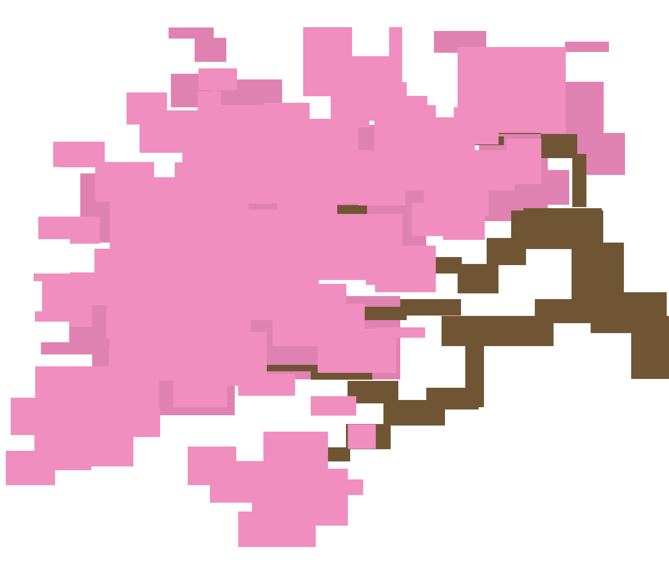

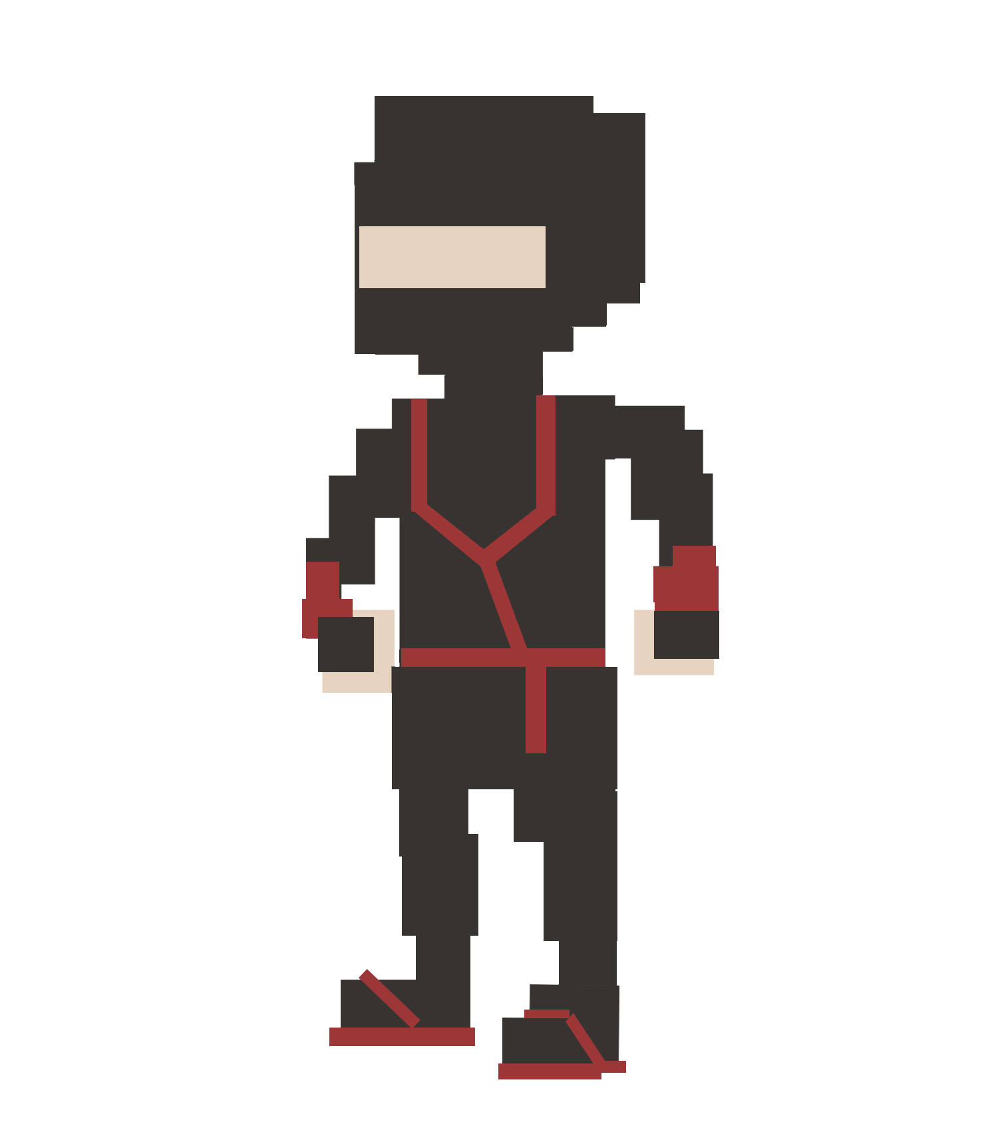

Slide 2
dash and slash
very

Slide 3
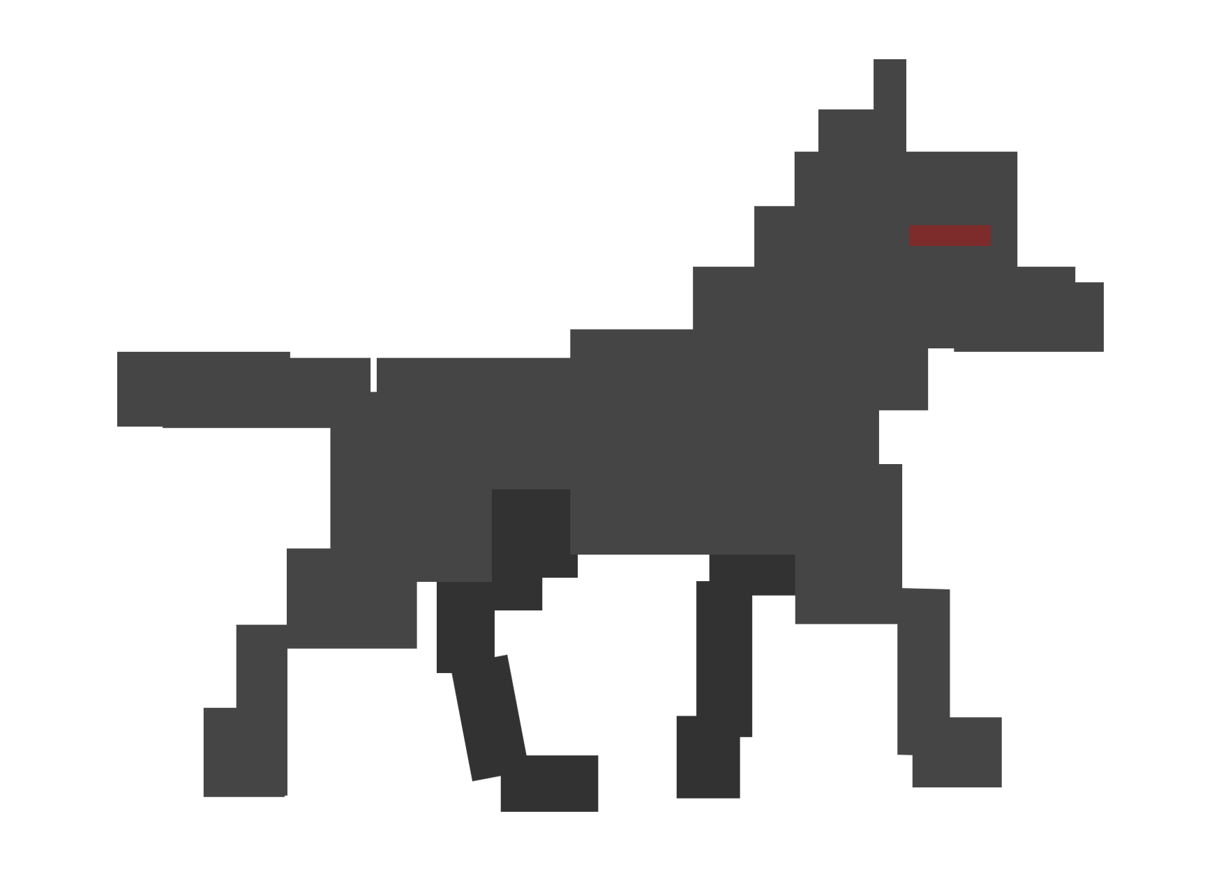
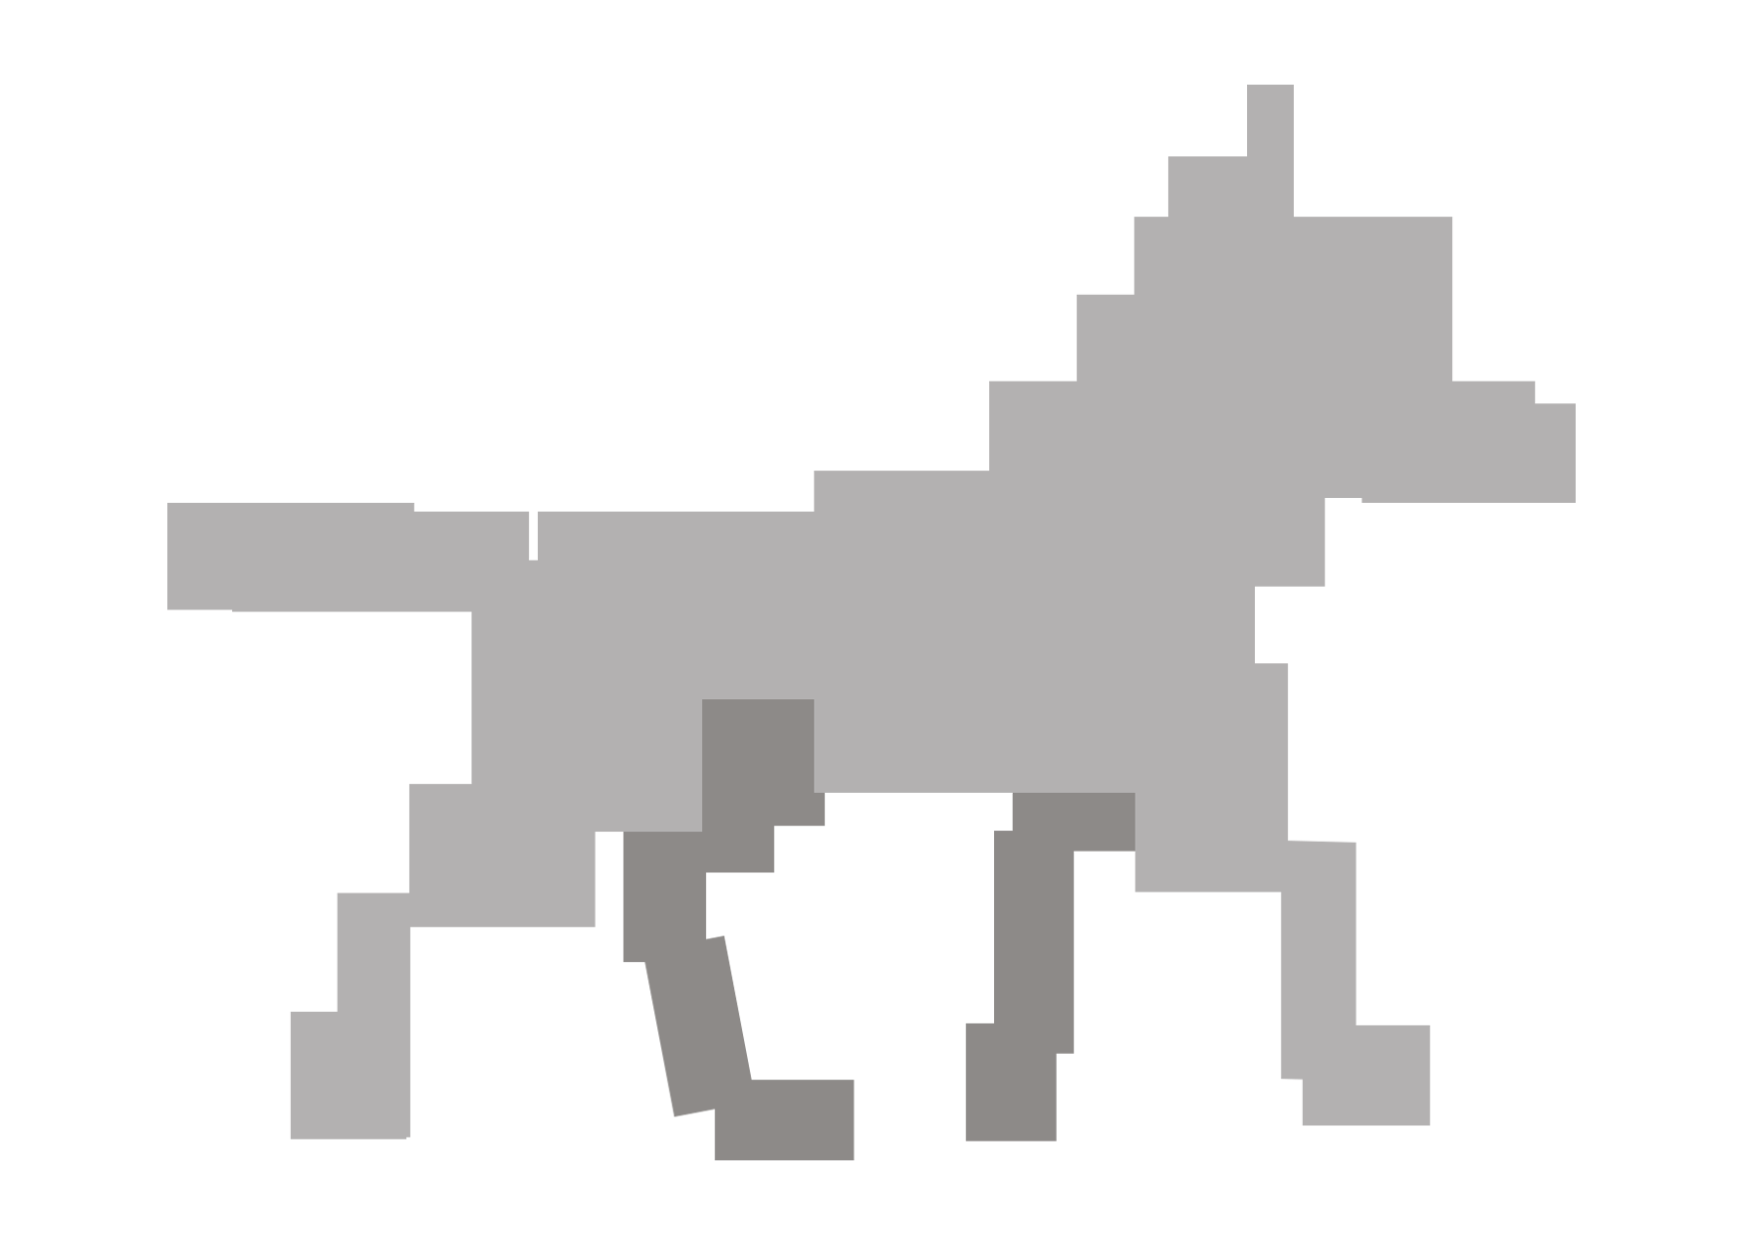
eehh evil wolve

Slide 4

dash through them
slash

Slide 5



powerups

Slide 6

yeah

